Slide 1


“Video games” what categories make it potentially successful
,,,Or so we thought
Presented by Sean Papworth & Fidencio Loza

Slide 2

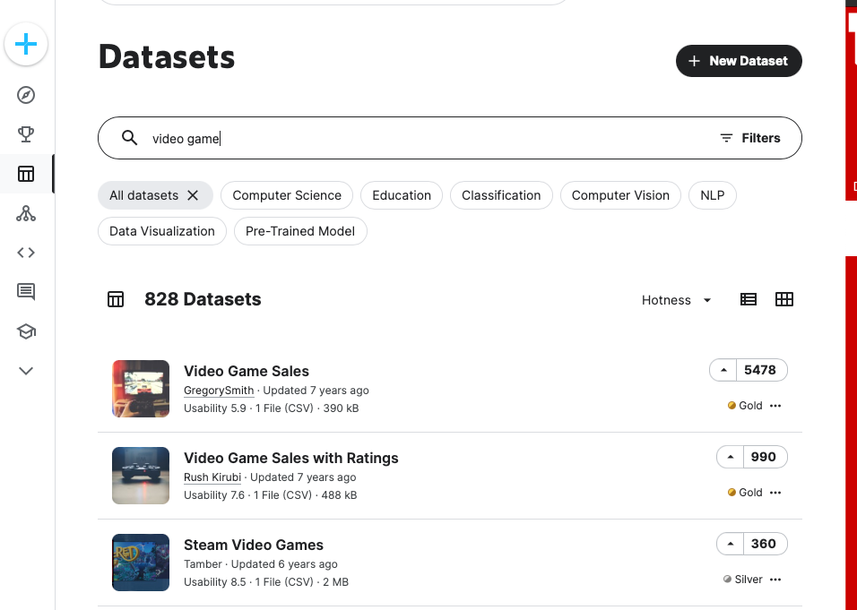
KAGGLE contained the most data sets that were available.
Out of the 828 that KAGGLE contained we opted for one based off IMBD information.
Some of these sets contained up to hundreds of thousands of rows of data. However, those sets proved to be difficult to work with in the timeframe we had.

Slide 3

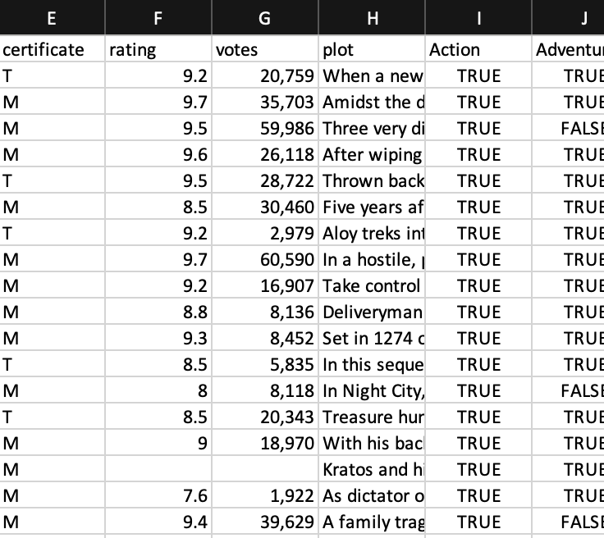
Pandas was our go to approach to clean the data.
This data set contained 20,804 rows of data which gives us a good start, especially if we wanted to expand to a greater data set with more rows.
First, we removed columns that would not help our charts and filtering.
Then we created separate data frames that featured key elements like Genre, Rating and Certificates for diversity. Here is a snippet of the sample data in the csv.

Slide 4
Rating & Vote.csv
We opted for a data set with the most potential considering the number of rows that were null
ETL Process
Genre.csv
Not Enough
KMEANS
DBSCAN
Certificate.csv
Not Enough
Analyze
Analyze

Slide 5
After the ETL the next question was, which approach would help us find more viable patterns?
KMEANS has difficulty with non-globular clusters and clusters of multiple sizes.
KMEANS
DBSCAN
DBSCAN is used to handle clusters of multiple sizes and structures and is not powerfully influenced by noise or outliers.
vs

Slide 6
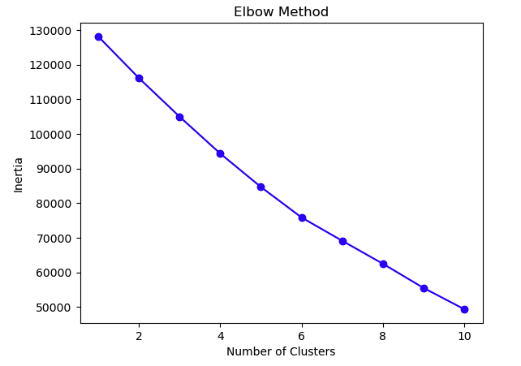
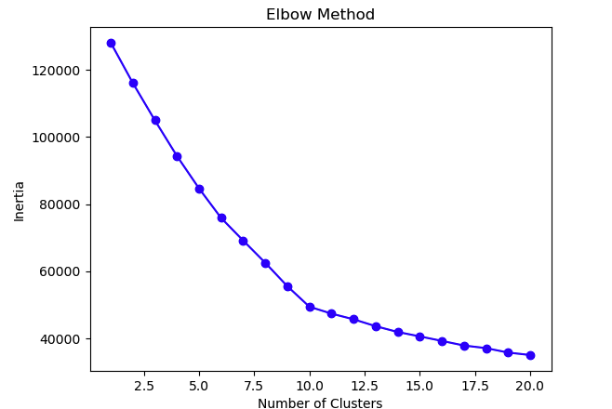
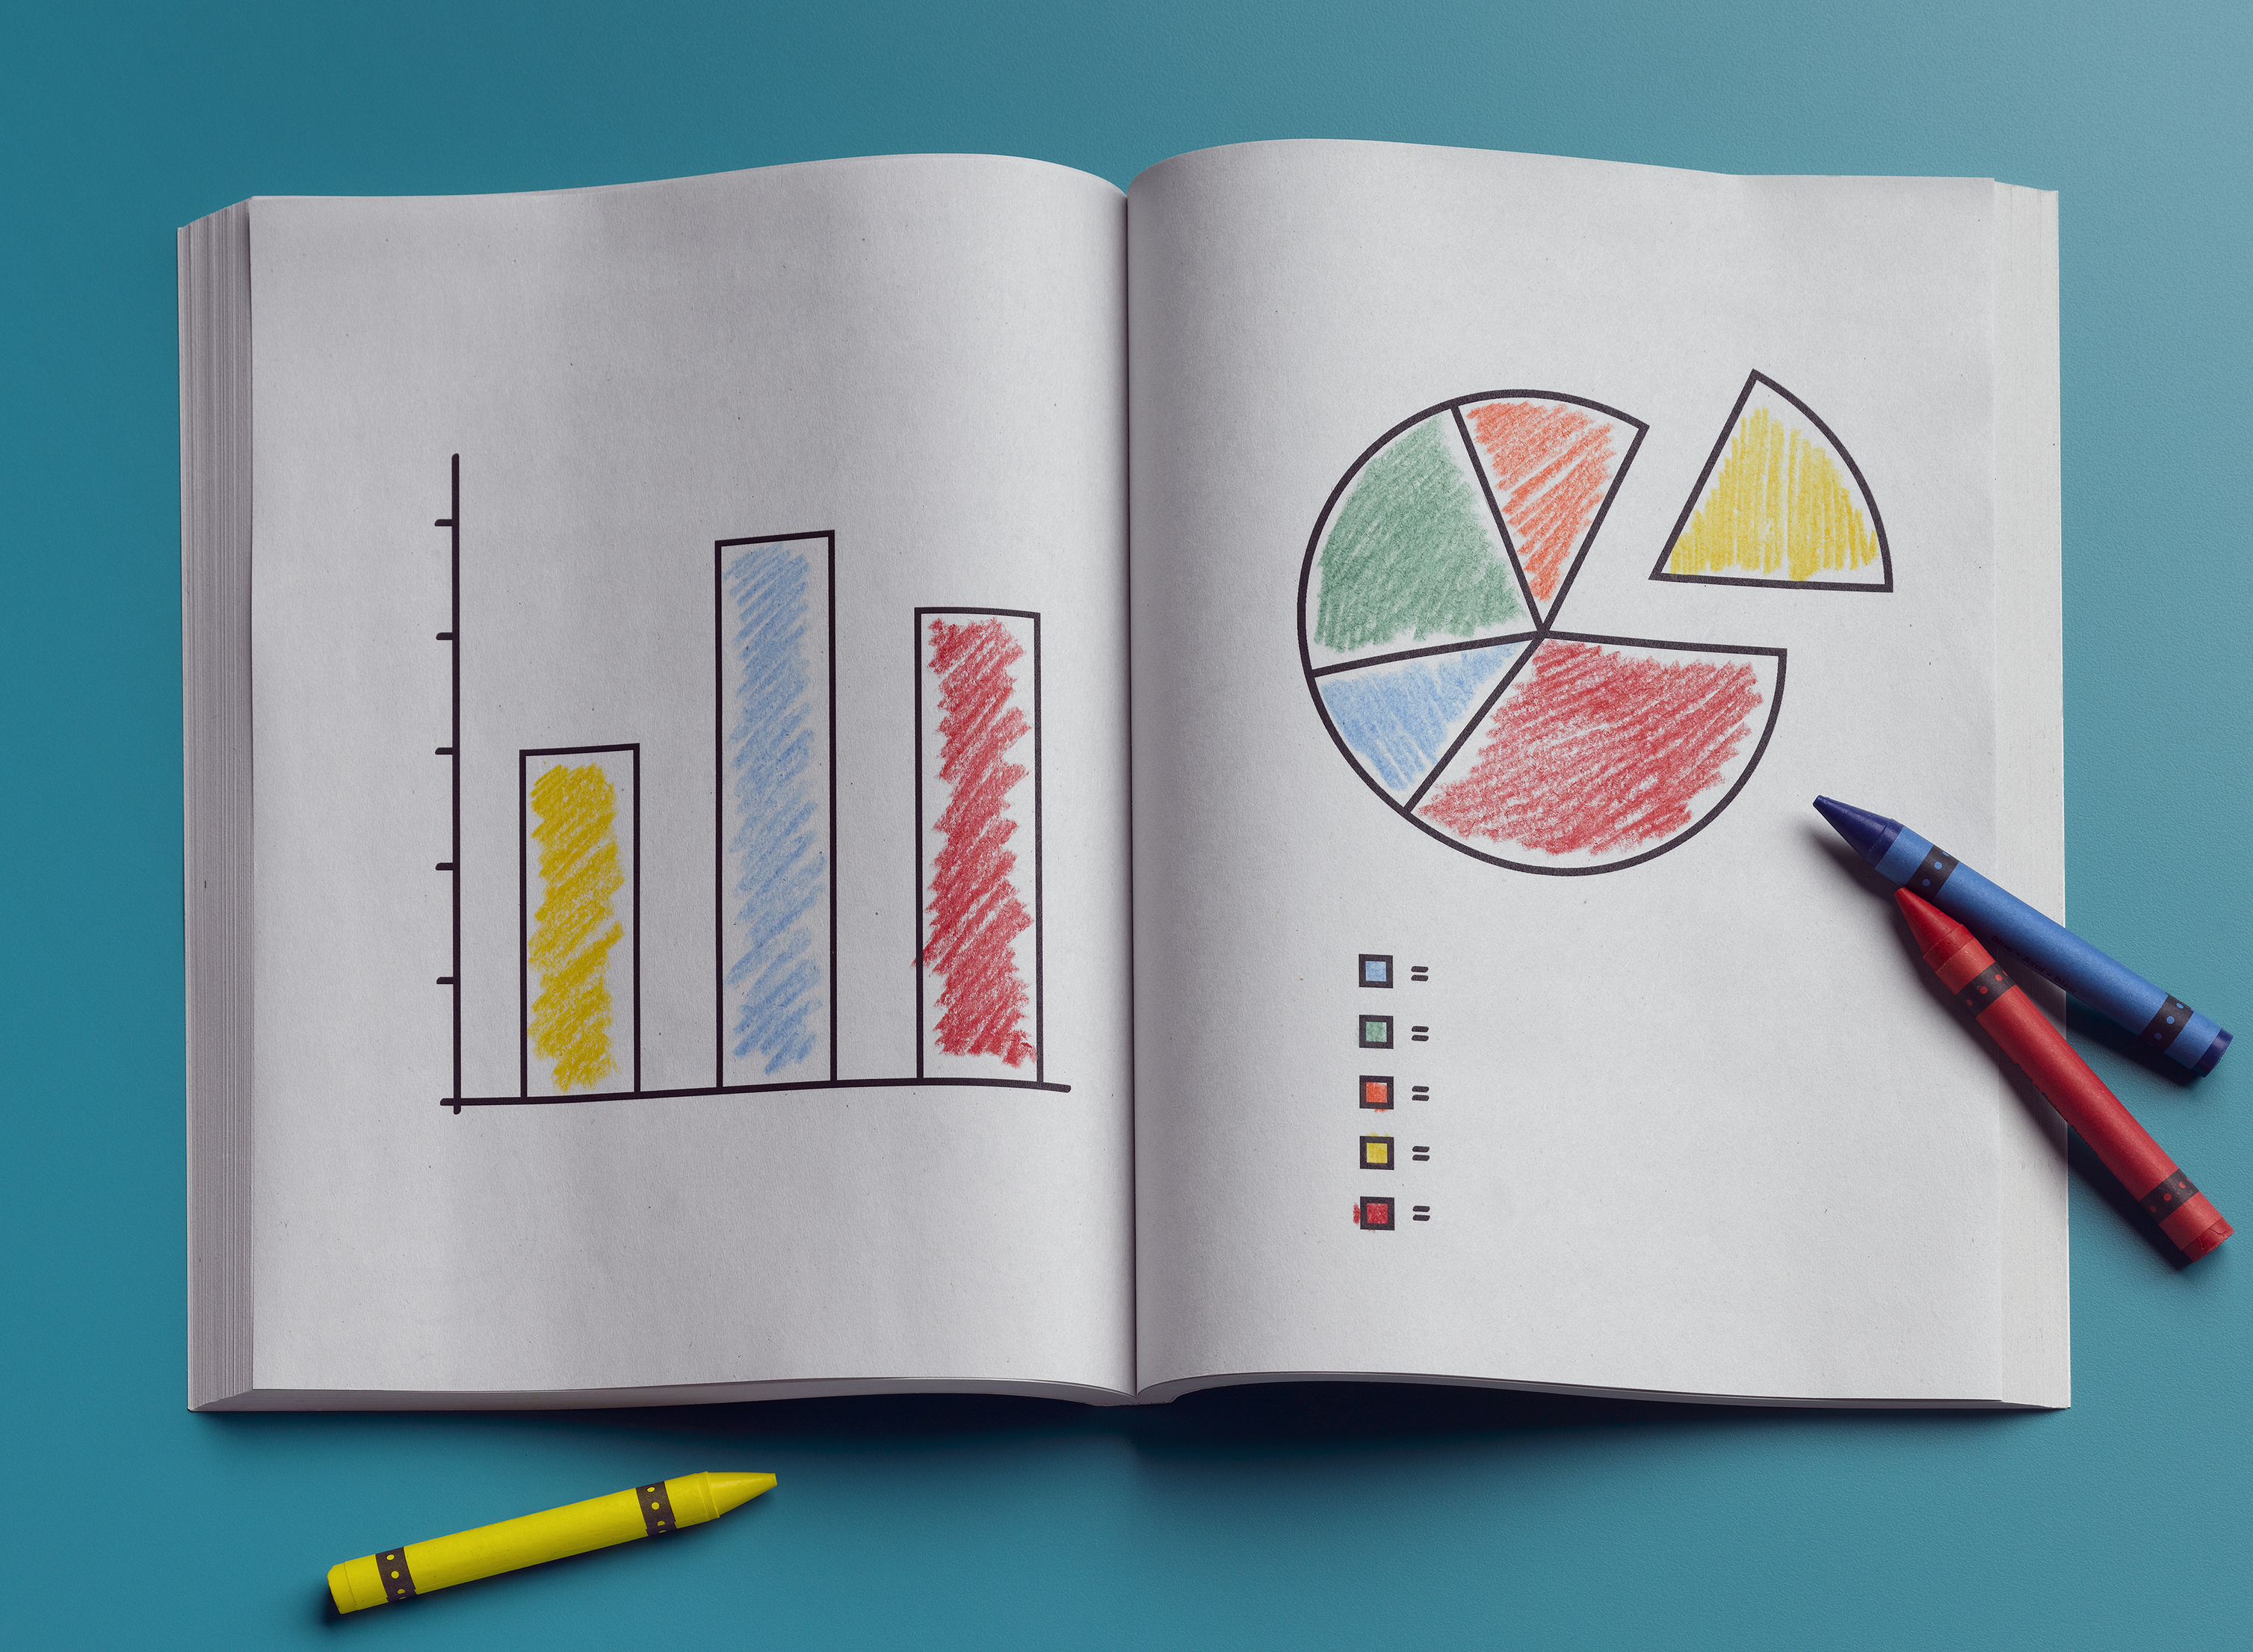
KMEANS Approach
One of the first charts proved that the rating cluster was affected by certain rows with no votes at all on the rating. The scale is thrown off by this considering the outliers are in 60k range.

Slide 7
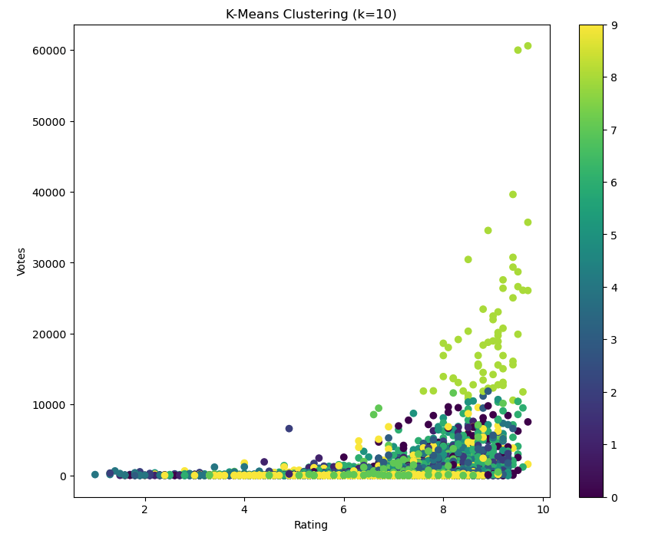
Initial Clustering
Using the “Elbow” method we derived that 10 clusters was an ideal amount. Our first scatter plot was to use clusters as the color and plot the data in votes over rating. Unfortunately, not much was gained in this chart due to the lack of disparity in the clusters near 0.

Slide 8
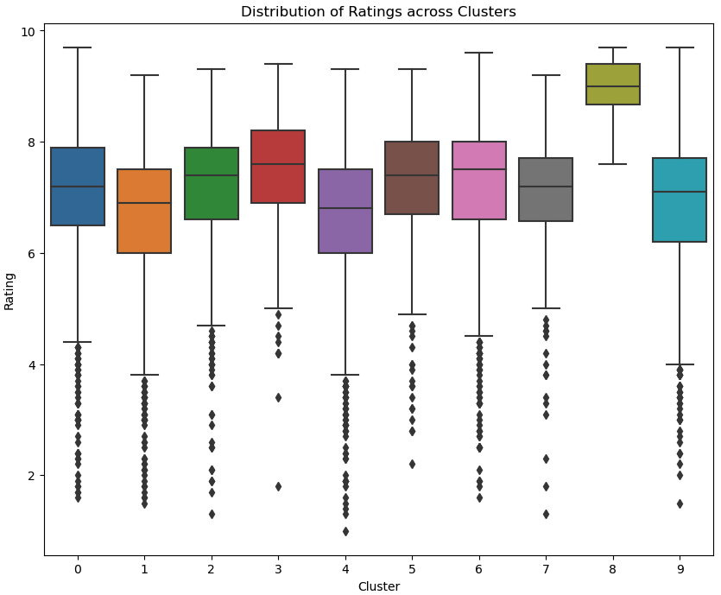
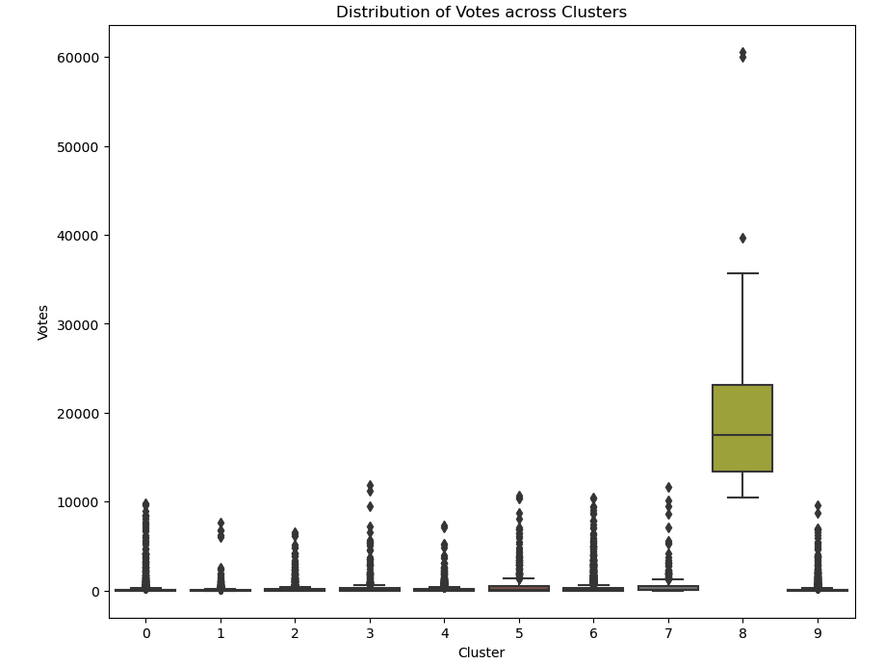
Ratings and Votes

Slide 9
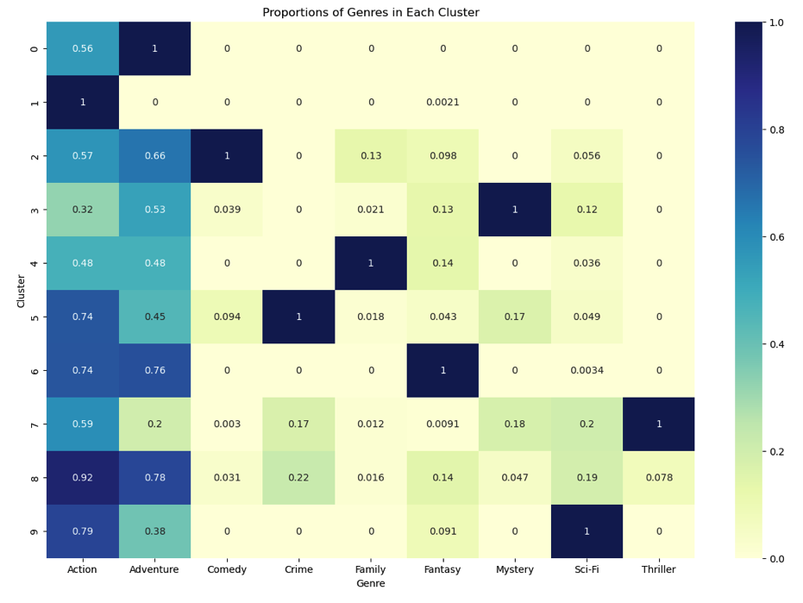
Proportions of Genres in Each Cluster
From this we noticed that each cluster had one predominant Genre e.g., Cluster 9 is all “Sci-fi” however “Action” and “Adventure” is distributed in all the clusters.

Slide 10
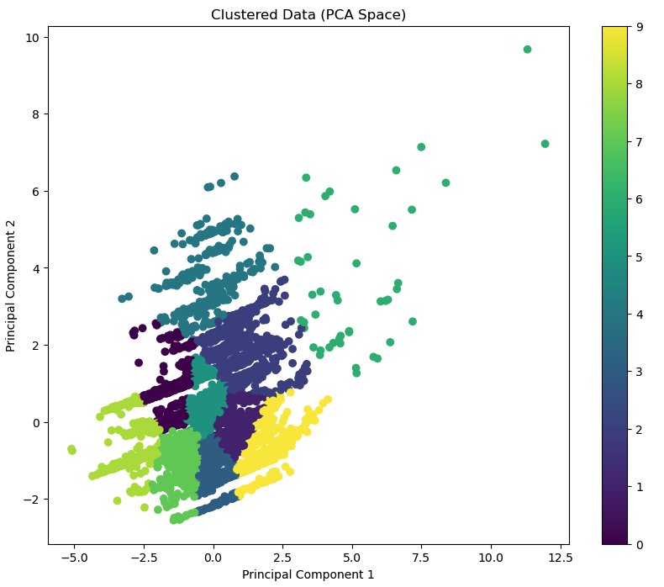
Principal Component Analysis
This should "graph" multi-dimensional clustering on a two-dimensional plane (hopefully).
Two principal components were used to create this plot.
Clearly shows different clusters.
Looks pretty but doesn’t tell the full story.
Only accounts for 25% of the information.

Slide 11
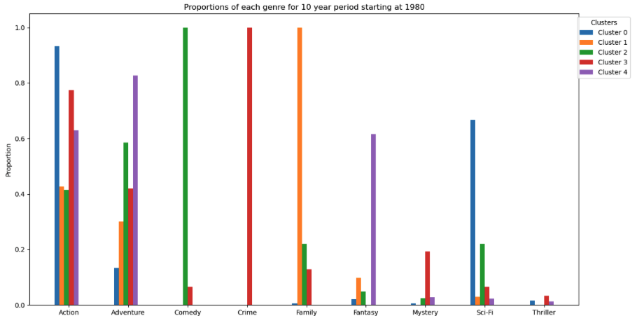
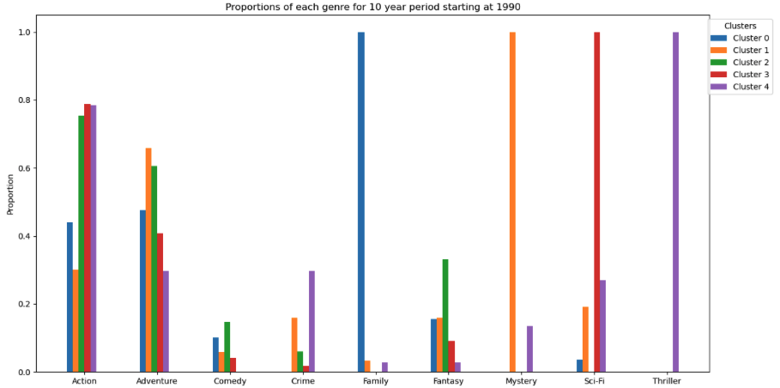
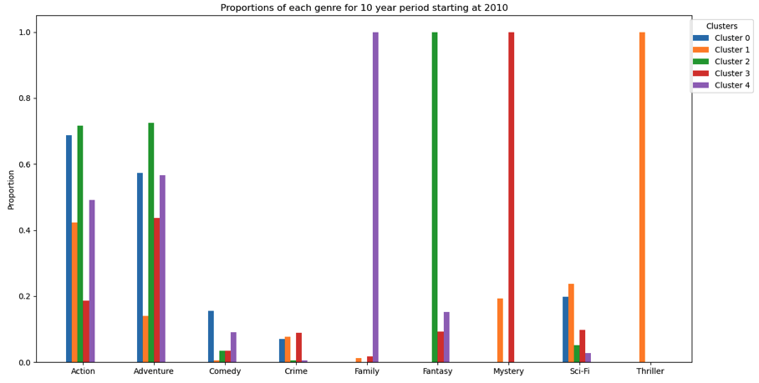
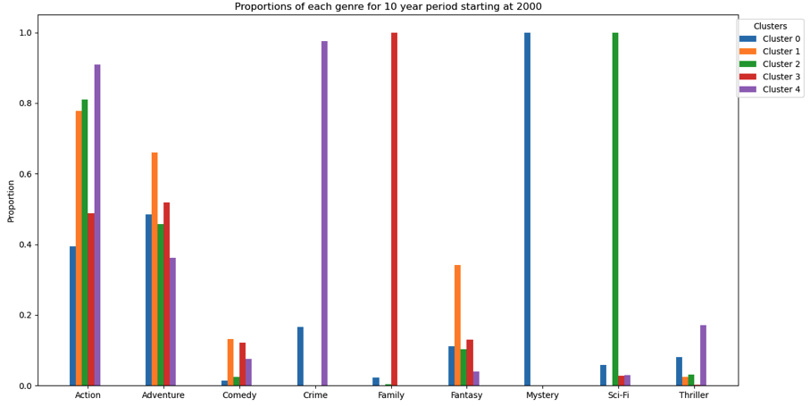
Decade proportion from 1990
Decade proportion from 1980
Decade proportion from 2010
Decade proportion from 2000

Slide 12
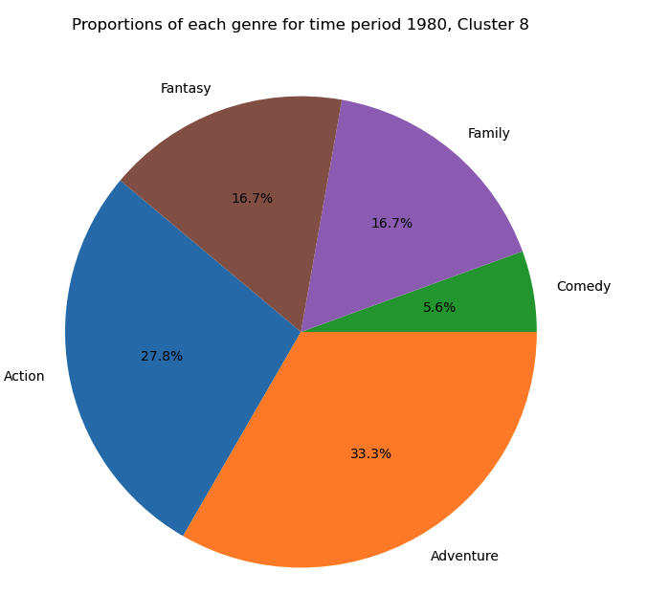
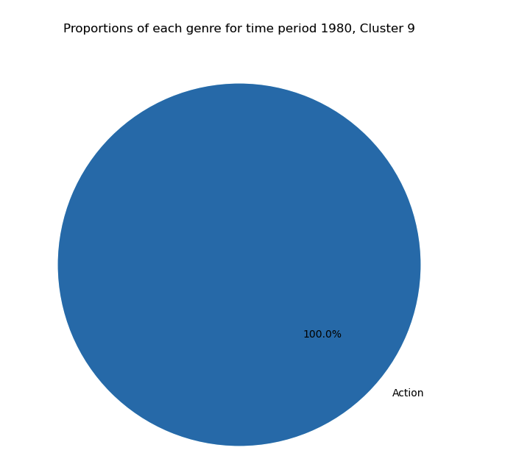

Slide 13
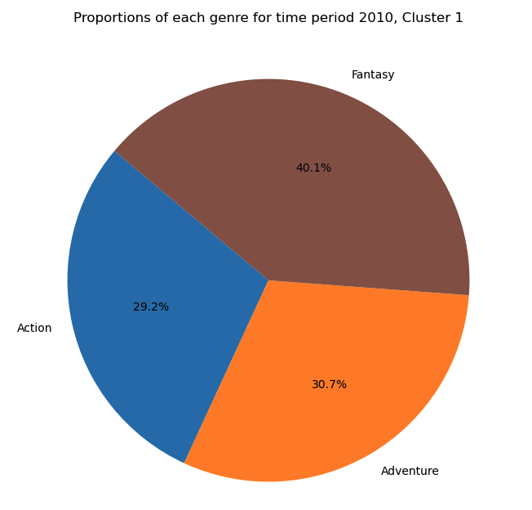
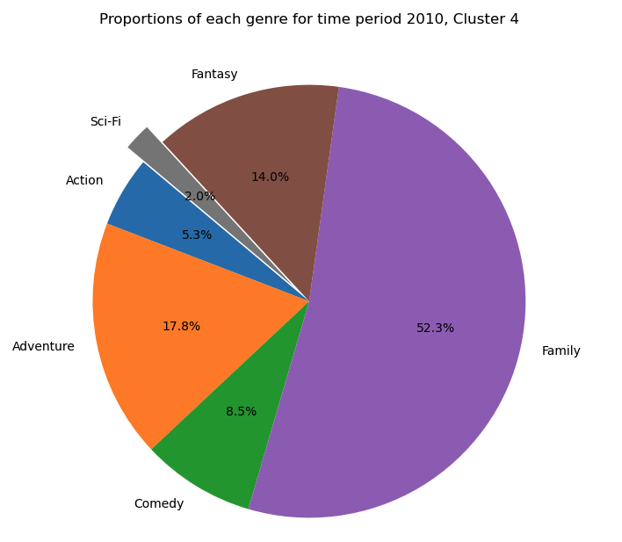

Slide 14


DBSCAN Approach
KMEANS was a good start but may have not been the best fit for our data set. This is why we opted for DBSCAN as the next approach.
The biggest difference between KMEANS and DBSCAN is that DBSCAN is a density-based clustering algorithm, which can be used to find clusters of any shape in a data set containing noise and outliers, and its clustering algorithm that could be useful in grouping together games with similar characteristics, for example, by the genre, rating, number of votes, etc.
We used the same data set and created the model as well as fit the model with the default parameters producing 84 clusters vs the 10 clusters from KMEANS ”Elbow”.

Slide 15
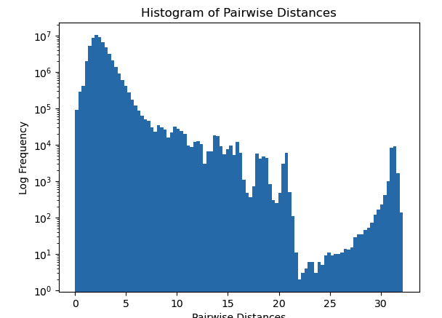
Are the default parameters the correct ones for our dataset?
A way to start this was by looking at a histogram plot of the pairwise distances in the dataset to help guide a choice of eps.
The process of looking at a histogram plot involves calculating the distance between each pair of points in the dataset, and then plotting a histogram of these distances.
This histogram is used to get a sense of what the eps value could be for the next run.
But,,,,, it didn’t work…

Slide 16
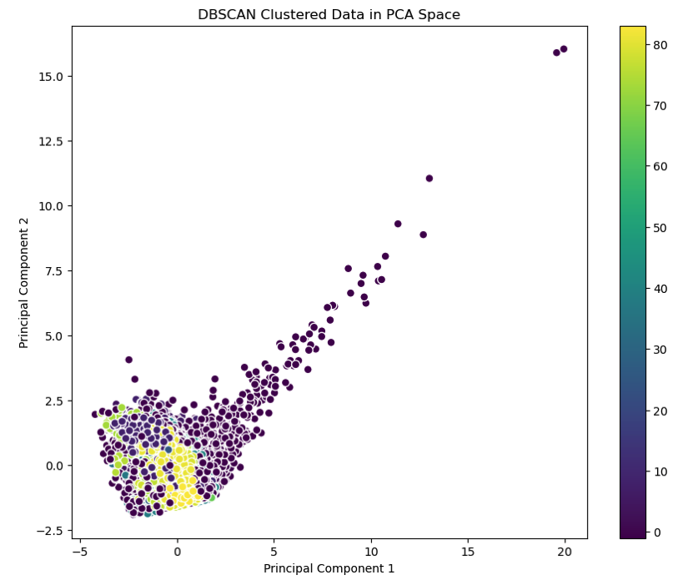
DBSCAN PCA
There were Two Principal Components Parameters used.
The Same method as KMEANS was used.
Unfortunately, it was not the best presentation.
Clearly shows the noise cluster including outliers.

Slide 17
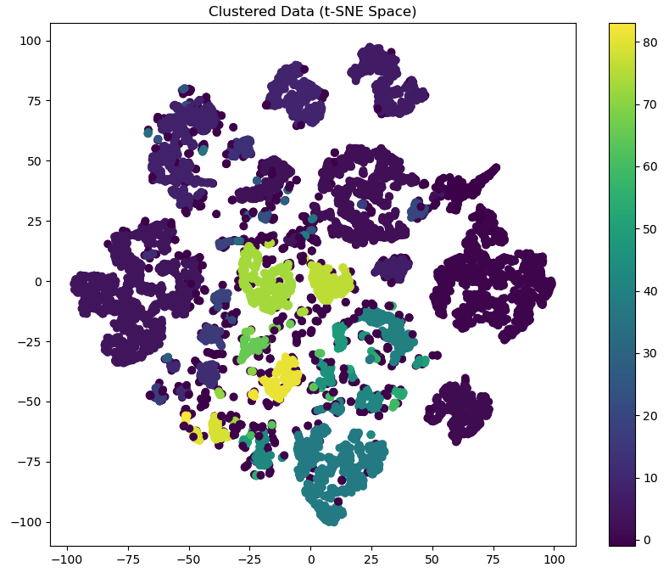
t-distributed Stochastic Neighbor Embedding (t-SNE)
Good at dimensionality reduction and well-suited for the visualization of high-dimensional datasets.
Shows distinction in our groups.
Distances between clusters might not always reflect their true relationships .
Better representation than PCA.

Slide 18
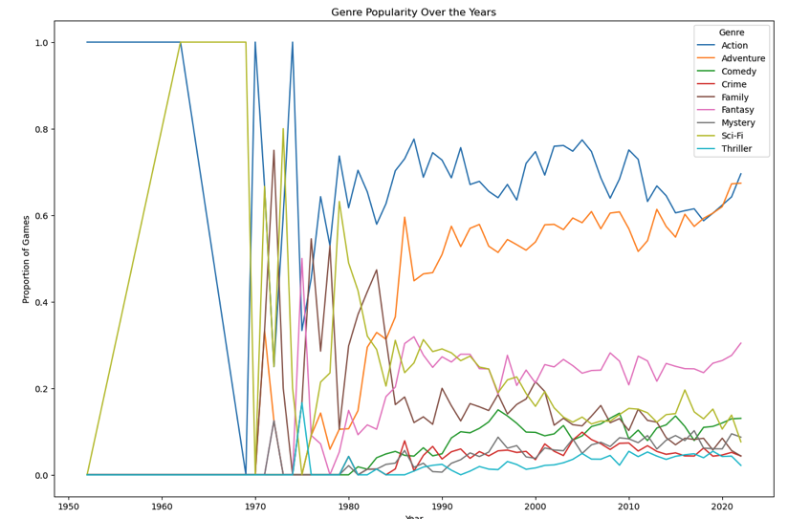
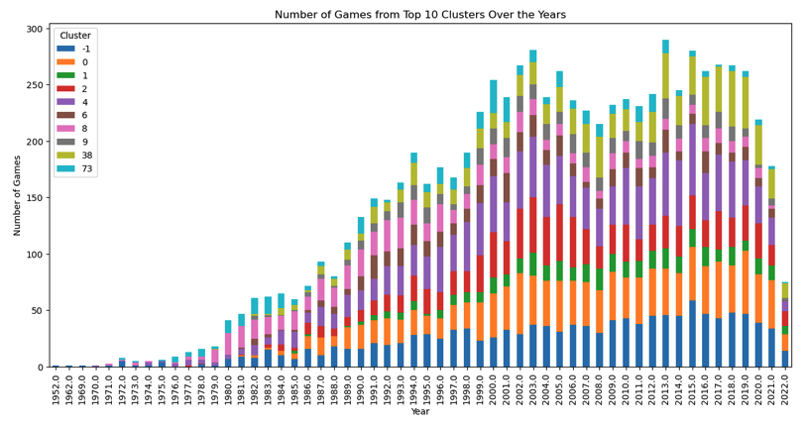
Standard Analysis Attempt
Genre Popularity over the Years
Number of Games from Top 10 Clusters over the Years

Slide 19
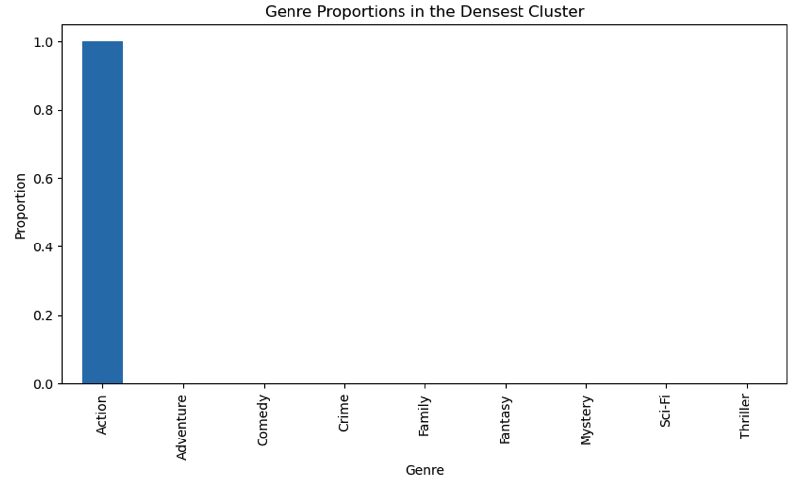
Discovering Dense Regions
Density of Clusters
Cluster 4
Number of rows 1415
Average rating: 6.679363957597173
Average votes: 73.90035335689046
Genre Proportions
Action 1.0
Adventure 0.0
Comedy 0.0
Crime 0.0
Family 0.0
Fantasy 0.0
Mystery 0.0
Sci-Fi 0.0
Thriller 0.0
Notes:
Clean up the lines of numbers

Slide 20
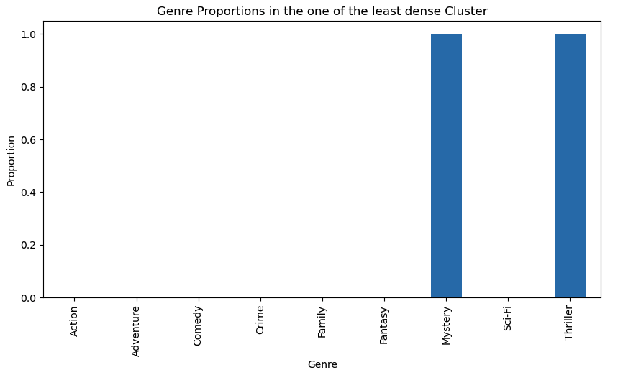
Discovering Dense Regions
One of least Dense Cluster
Cluster 80
Number of Rows 32
Average rating: 7.1875
Average votes: 154.0625
Genre Proportions
Action 0.0
Adventure 0.0
Comedy 0.0
Crime 0.0
Family 0.0
Fantasy 0.0
Mystery 1.0
Sci-Fi 0.0
Thriller 1.0
Notes:
Get updated picture

Slide 21
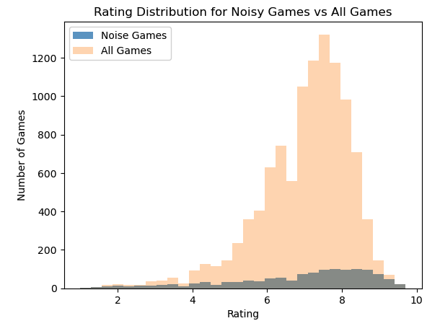
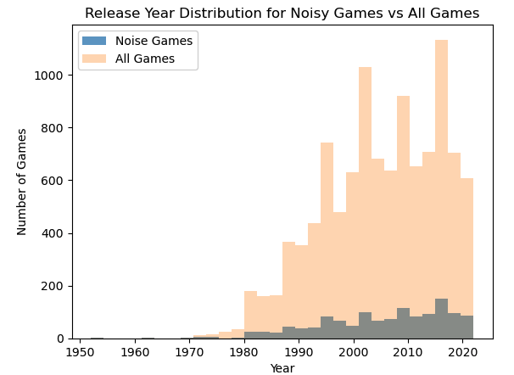
Analyzing Noise
Notes:
Crop or stretch

Slide 22



KMEANS
DBSCAN
So DBSCAN did give us different results than KMEANS, but as mentioned in the KMEANS effort, having the proper context and using the suitable model is extremely important, and being very new to this, we stumbled around the forest at night without a flashlight. We learned many things, a few tricks, and not to take unsupervised ML lightly. We also learned that having the correct data to work with and knowing what types of features you can create with that data makes a big difference.
We did find another dataset that was many times bigger, and if we had more time after learning what we learned from these two rounds of unsupervised ML, we would want to apply our experience to that dataset. A considerable part of any dataset is the ETL process, and this more extensive dataset does require quite a bit more effort in the ETL. One thing we wanted to try was a merge since each dataset came from different websites originally. But our time is up, and this is as far as we got. We thank you for stepping through our process with us, and we hope you learned a thing or two about incorporating unsupervised ML into any future project. There is a lot more information to this if you want a more technical explanation of this project. Check out our project 4 at https://github.com/jrfloza12/Project4

